Slide 1

Optimize the Power Consumption of Zone 1 based on various environmental and meteorological factors in Wellington, New-Zealand

Slide 2

Data Overview
DATASET SIZE 52,584 records and 9 columns
FEATURES Serial Number, Temperature, Humidity, Wind speed, General Diffuse Flow (m²/sec), Diffuse Flow (m²/sec), Air Quality Index (particles in microgram per cubic meter), Cloudiness (Yes-1, No-0)
TARGET VARIABLE Zone 1 Power Consumption (KWR)

Slide 3
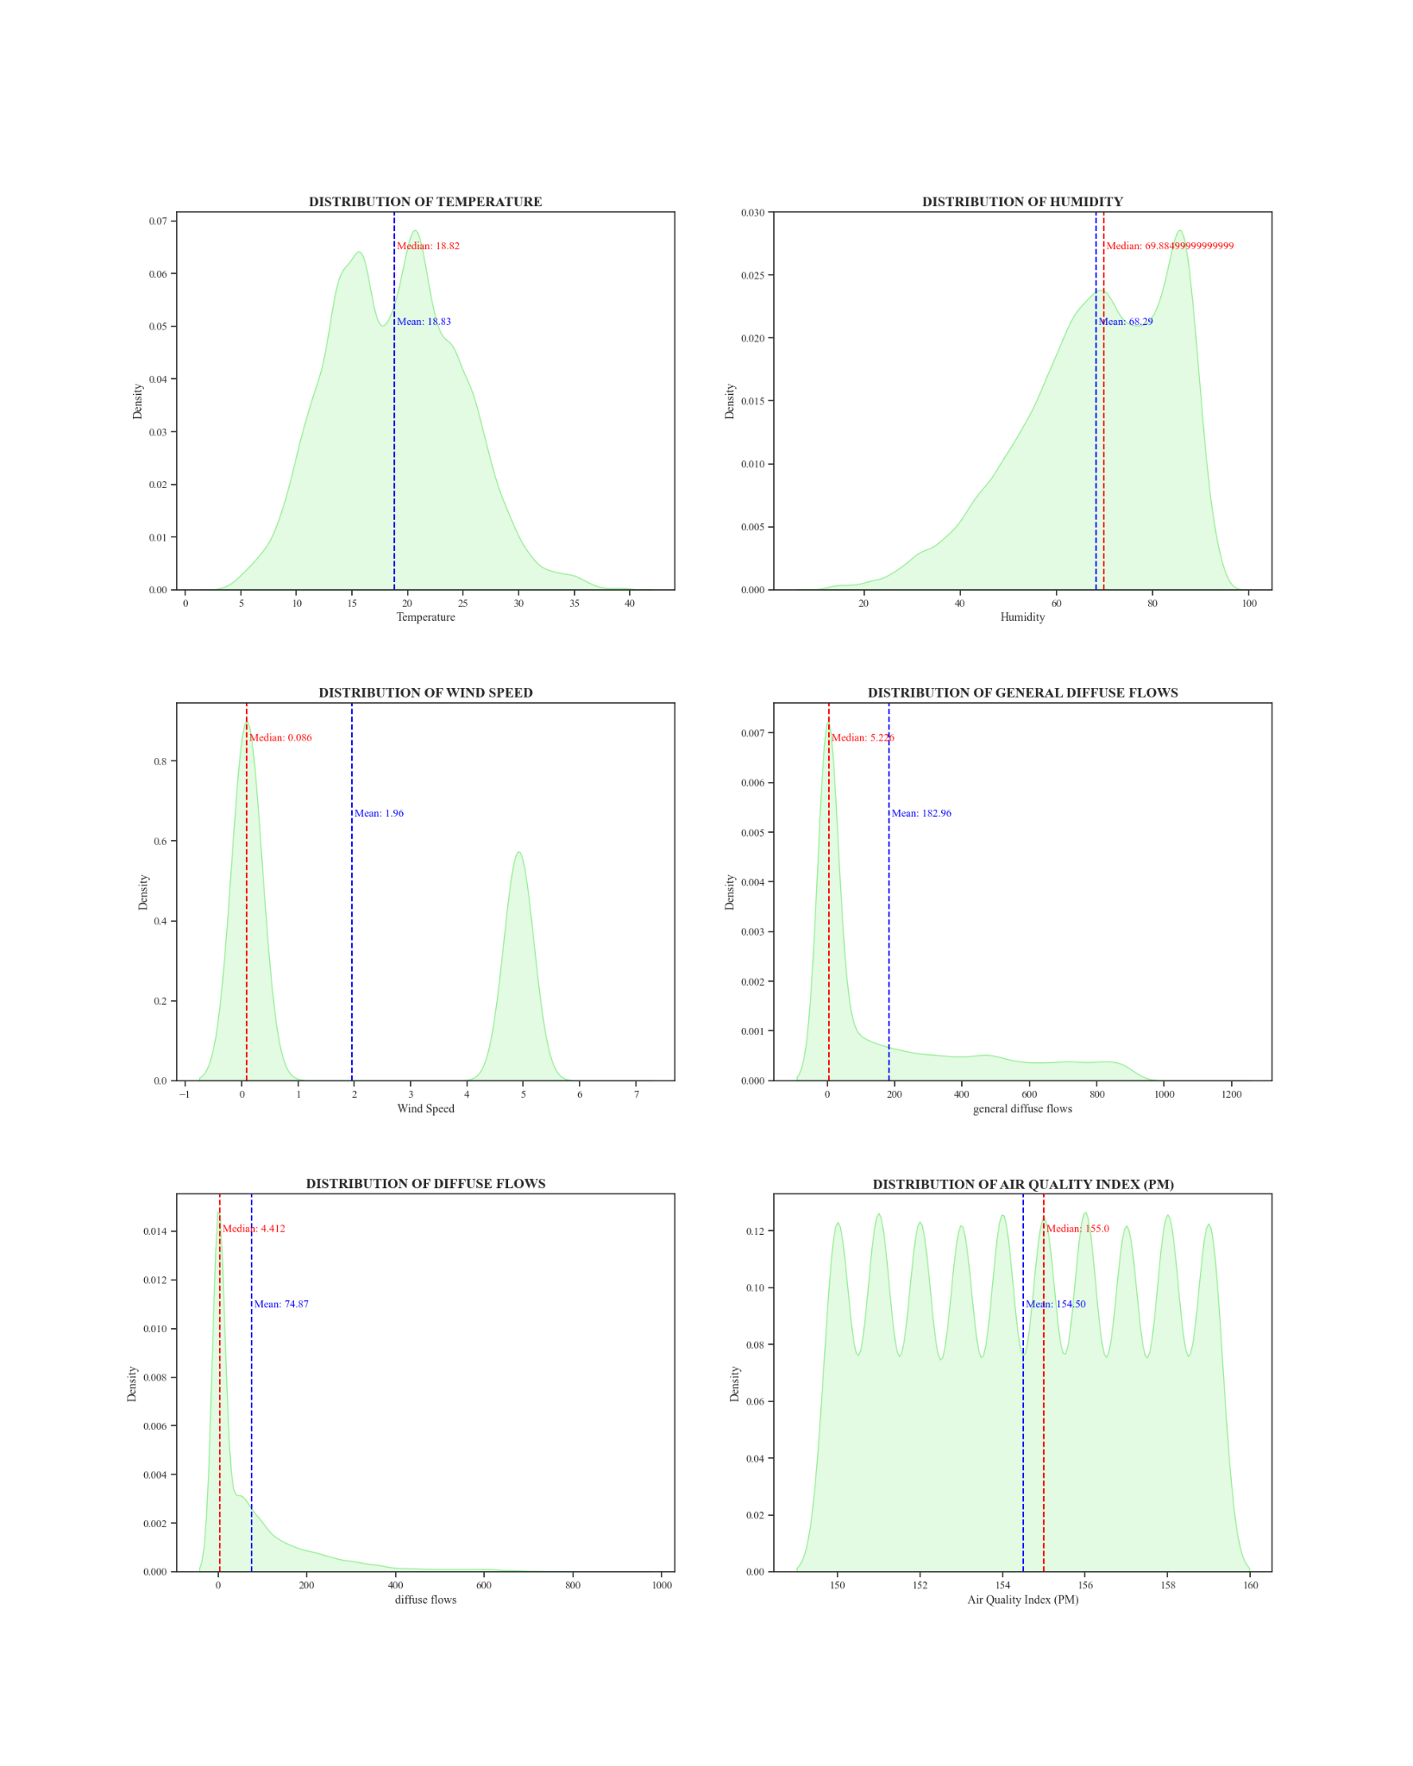
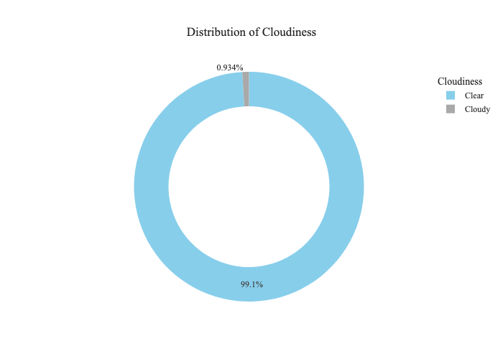
Exploratory Data Analysis - I
Kernel-density plot showing numerical data distribution, helps identify potential outliers
Pie chart showing categorical data distribution (Cloudiness)

Slide 4
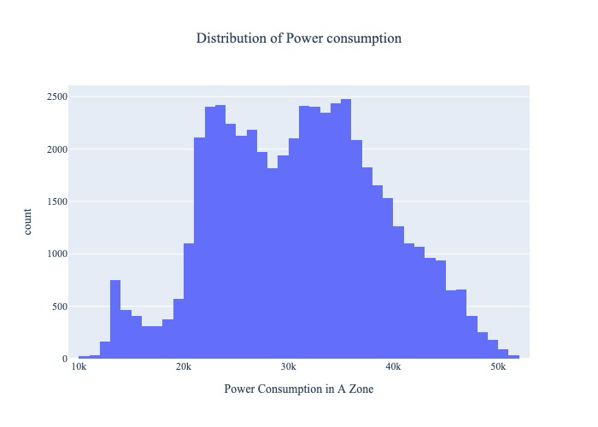
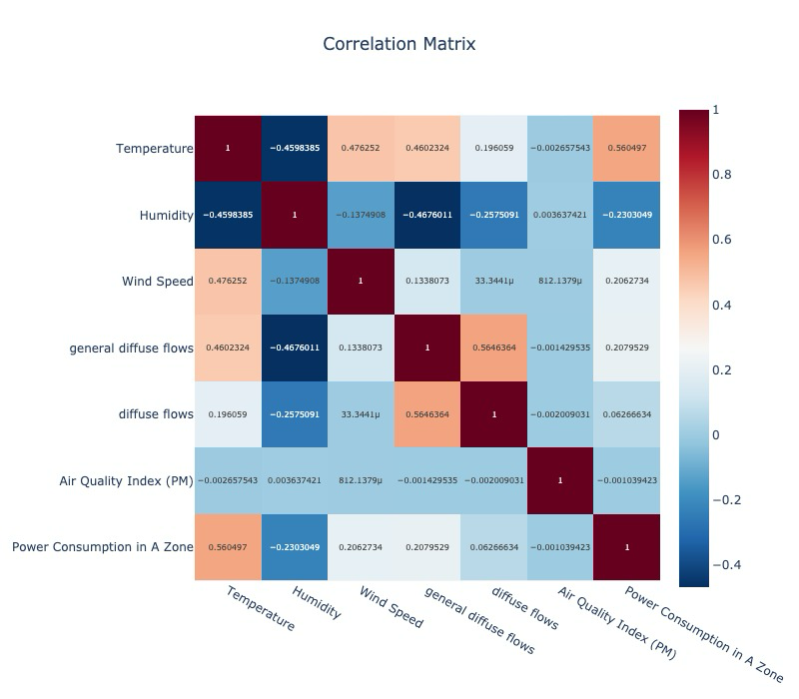
Exploratory Data Analysis - II

Slide 5
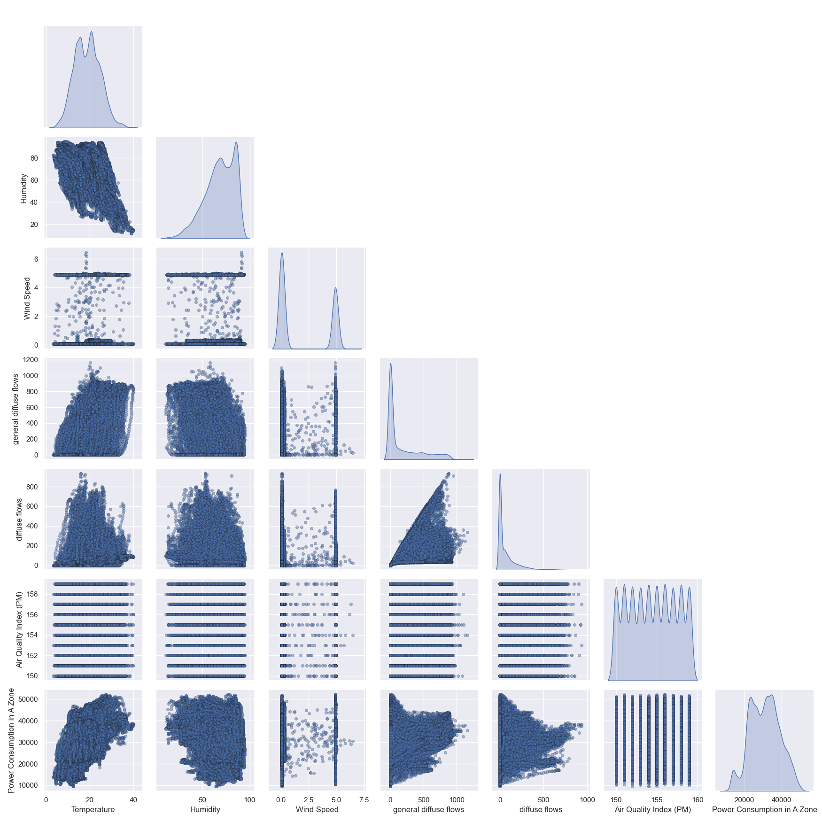
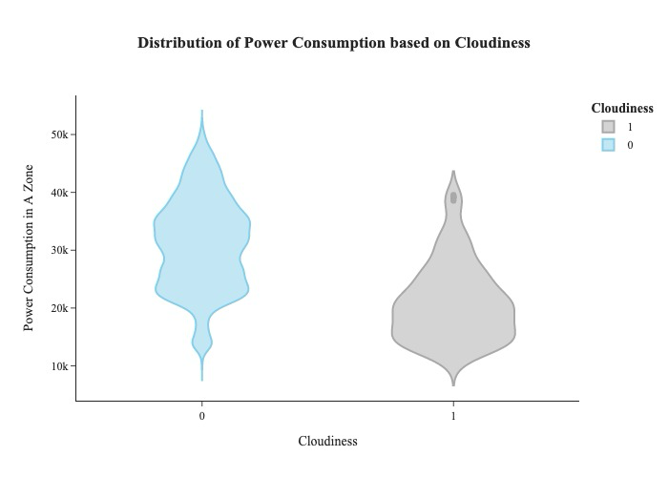
Exploratory Data Analysis - III

Slide 6
Data Preprocessing
1
Handling Missing Values
Applied Simple and KNN Imputation to handle missing values
2
Outlier Treatment
Applied IQR method to reduce impact of extreme values
Train-Test Split
3
Splitting the data into x_train, x_test, y_train, y_test.
Feature Scaling
4
Applied min-max scaling, good for non-gaussian distribution

Slide 7
Model Selection
Model | Training R² Score | Testing R² Score | MAE | MSE
Linear Regression | 0.325 | 0.331 | 5299.85 | 4,32,08,675.96
K Nearest Neighbors | 0.578 | 0.373 | 4774.46 | 4,05,05,776.52
Decision Tree | 0.999 | 0.263 | 4224.07 | 4,76,09,390.04
Random Forest Regression | 0.948 | 0.634 | 3397.88 | 2,36,14,592.41
Support Vector Regressor | 0.081 | 0.087 | 6133.69 | 5,89,69,665.39
XGBoost Regression | 0.664 | 0.553 | 3978.22 | 2,88,69,645.76
AdaBoost | 0.338 | 0.344 | 5320.88 | 4,23,74,529.71
Gradient Boosting | 0.439 | 0.435 | 4742.7 | 3,64,91,475.43
RandomForestRegressor is the best-performing model with the highest test R² (0.63), lowest MAE and MSE.

Slide 8
Model Training and Evaluation
Data Splitting
Performance Metrics
80% training, 20% testing split for model evaluation.
Evaluated model using r2_score, mean square error
and mean absolute error.
1
2
3
4
Hyperparameter Tuning
Feature Importance
Used RandomSearchCV and GridSearchCV
to optimize model parameters.
Used feature importance to identify
the most important features.

Slide 9
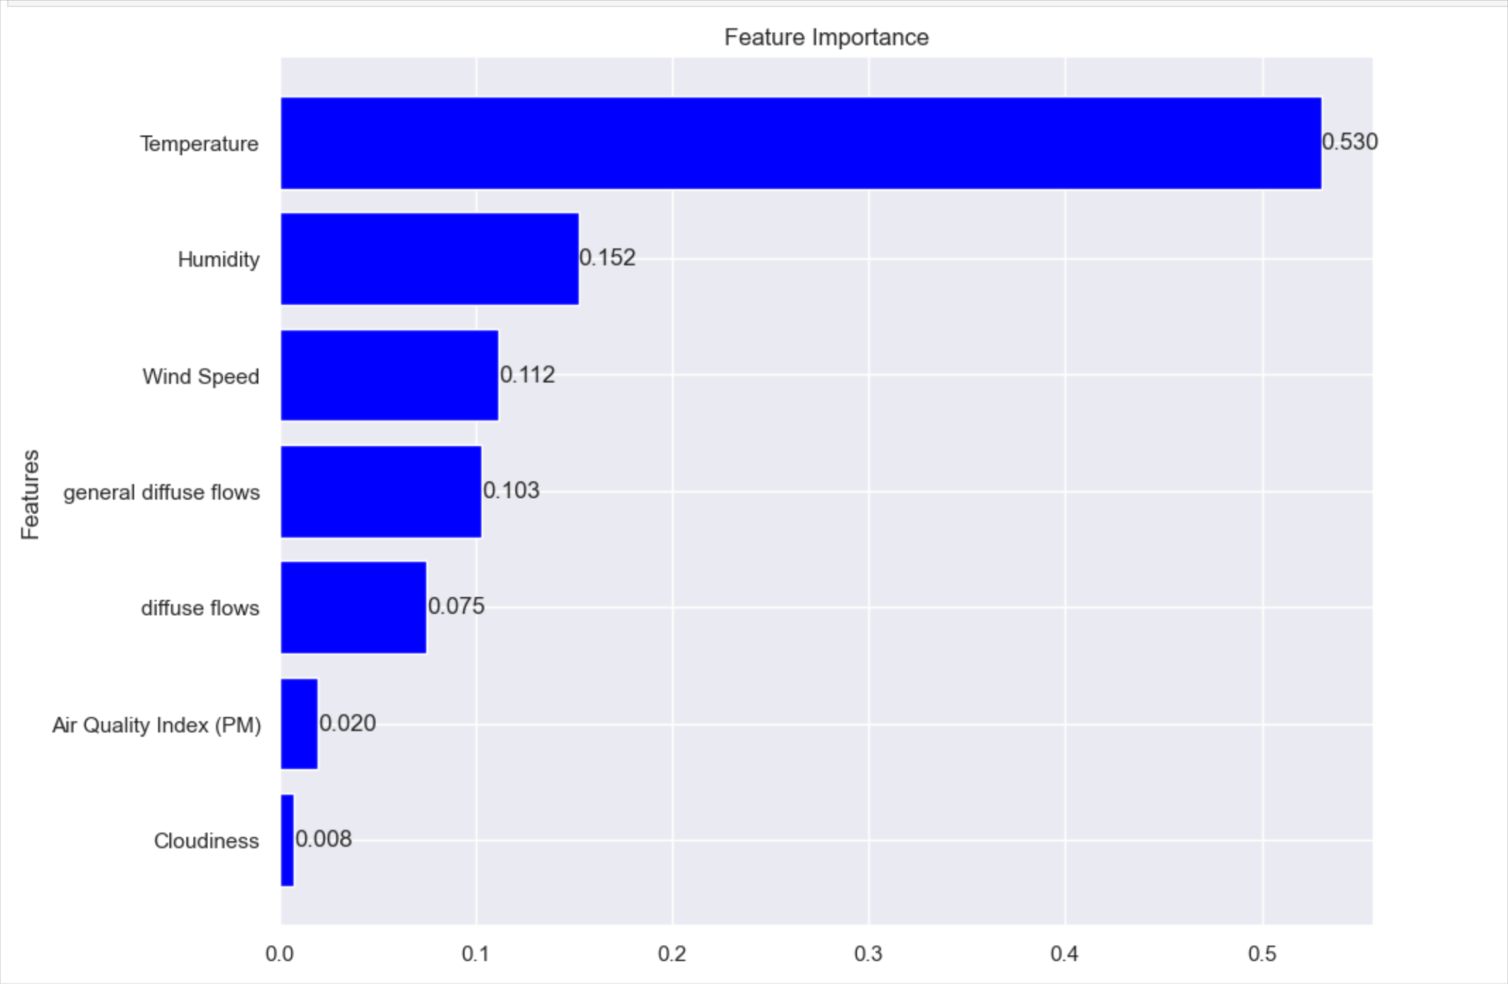
Performance Metrics and Feature Importance
Result Metrics after Hyperparameter Tuning
Metric | Value
Training R² Score | 0.7898
Testing R² Score | 0.6191
Mean Absolute Error | 3564.68
Mean Squared Error | 1,35,07,828.02

